Slide 2

Modern Web Development in Azure
Hamida REBAI
Architect, Microsoft MVP Developer Technologies

Slide 3




Hamida REBAI TRABELSI
MVP in Developer Technologies
Software architect
@rebaihamida
didourebai@gmail.com
https://www.linkedin.com/in/hamida-rebai-trabelsi-09b8525/

Slide 4
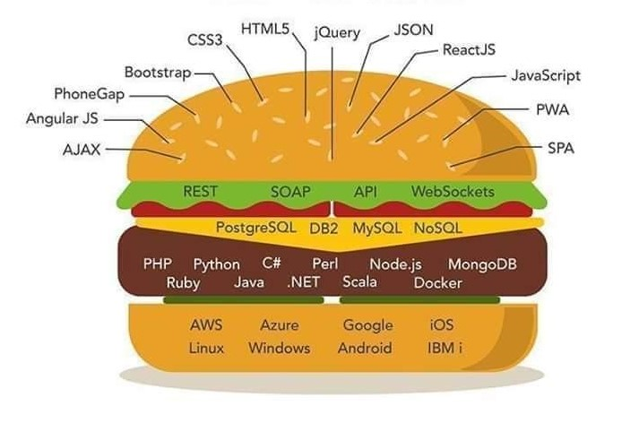
Agenda
Client side web technologies
Server side web technologies
SGBDR and NoSQL
Languages
OS and Cloud Provider
Notes:
I hope that you enjoyed your dinner today because today we will talk about food sandwich, italian food.
What do you thing?
Let’s start by our sandwich.
To build any project, you need to have an idea about every layer presented her.
We have to know about client side web technologies that we can use it.
Server side web technologies. We have to choose the language and the framework, then the architecture that can be a monolith or microservices and Cloud Native Apps for and in the end we will deploy it in the cloud like Microsoft Azure or other cloud provider.
So what is required to build modern application for a user?

Slide 5
Introduction
Modern web applications have higher user expectations and greater demands than ever before.
Available from anywhere in the world.
Usable from virtual any device or screen size.
Secure, flexible and scalable.
Cross platform.
Modular and loosely coupled.
Simple development and deployment.
Cloud-hosted
Notes:
Modern web applications have higher user expectations and greater demands than ever before. Today's web apps are expected to be available 24/7 from anywhere in the world, and usable from virtually any device or screen size. Web applications must be secure, flexible, and scalable to meet spikes in demand. Increasingly, complex scenarios should be handled by rich user experiences built on the client using JavaScript, and communicating efficiently through web APIs.

Slide 6
Client side web technologies
Notes:
We will start from the top of our sandwich to mention client side web techologies that we can use it in any kind of project.

Slide 7
JavaScript libraries and frameworks
Notes:
Popular JavaScript libraries and frameworks are incredibly useful tools for any front-end web designer to be familiar with. They can add powerful functionality to your site or help you create current web design trends, resulting in exceptional experiences for your users.

Slide 8








JavaScript Framework
Notes:
Aurelia
Angular
Ember
Ionic
Mocha
Next.js
Vue.js
Webix

Slide 9








JavaScript Libraries
Notes:
JavaScript is one of the most popular programming languages on the web. A JavaScript library is a library of pre-written JavaScript which allows easier access throughout the development of your website or application. For example, you can include a copy of Google’s hosted jQuery library by using the following snippet.
jQuery: A fast, small, and feature-rich JavaScript library.
BackBoneJS: Give your JS app some backbone with models, views, collections, & events.
D3.js: A JavaScript library for manipulating documents based on data.
React: Facebook’s JavaScript library developed for building user interfaces.
jQuery UI: A curated set of user interface interactions, effects, widgets, and themes.
jQuery Mobile: HTML5-based user interface system designed to make responsive web sites.
Underscore.js: Functional programming helpers without extending any built-in objects.
Moment.js: Parse, validate, manipulate, and display dates in JavaScript.
Lodash: A modern utility library delivering modularity, performance, & extras.

Slide 10


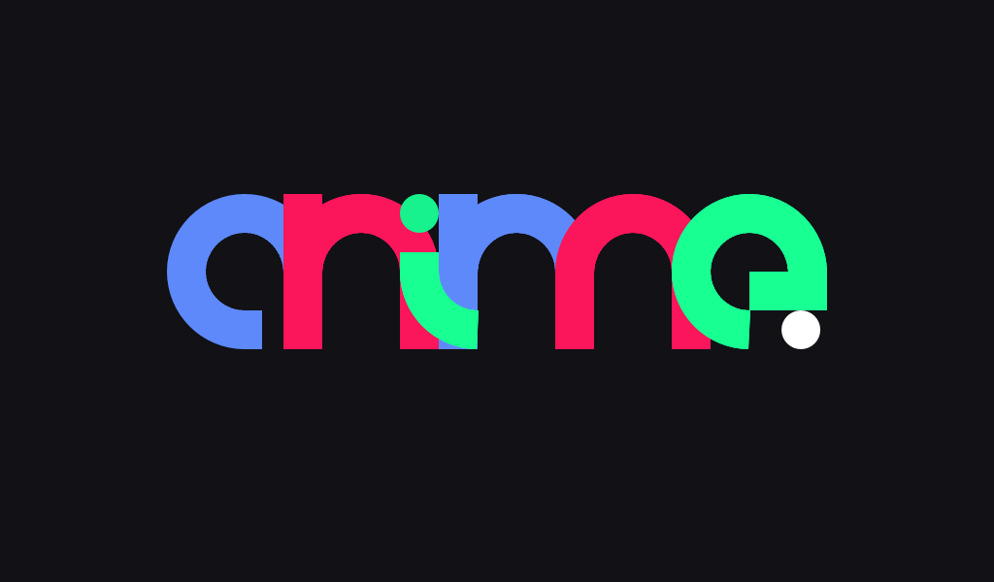
JavaScript libraries
Algolia Places
anime.js
AOS – Animate On Scroll
Bideo.js
Chart.js
Choreographer-js
Cleave.js
Glimmer
Granim.js
Multiple.js
Omniscient
Parsley
Popper.js
Premonish
Slick
TaffyDB
TweenJS
Three.js, Voca

Slide 11
Front-end Frameworks

Slide 12



Front-end Frameworks
Notes:
Front-end frameworks usually consist of a package that is made up of other files and folders, such as HTML, CSS, JavasScript, etc. There are also many stand-alone frameworks out there. We are a big fan of Boostrap and the main KeyCDN website is built on it. A solid framework can be an essential tool for front-end developers.
Bootstrap: HTML, CSS, and JS framework for developing responsive, mobile first projects on the web.
Semantic UI: Development framework that helps create beautiful, responsive layouts using human-friendly HTML.
uikit: A lightweight and modular front-end framework for developing fast and powerful web interfaces.

Slide 13
Web Application Frameworks
Notes:
Popular JavaScript libraries and frameworks are incredibly useful tools for any front-end web designer to be familiar with. They can add powerful functionality to your site or help you create current web design trends, resulting in exceptional experiences for your users. I

Slide 14







Web Application Frameworks
Notes:
Knockout and angular
Frontend Development
React and Vue.js
Django: High-level Python Web framework that encourages rapid development and clean, pragmatic design.
pragmatic design.
ASP.net: Free, fully supported Web application framework that helps you create standards-based Web solutions.
Laravel: A free, open source PHP web application framework to build web applications on MVC pattern.

Slide 15
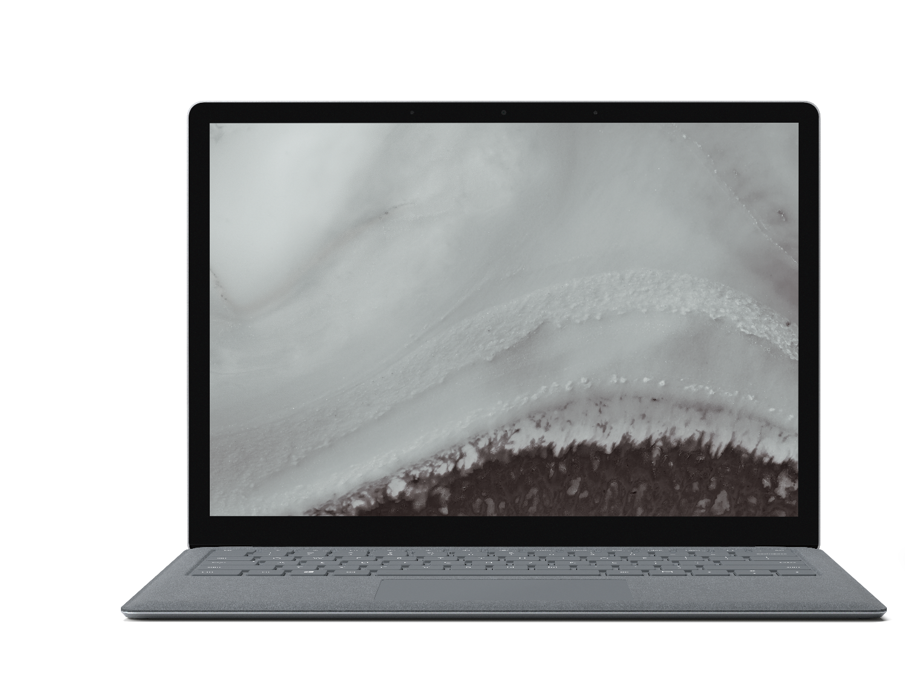
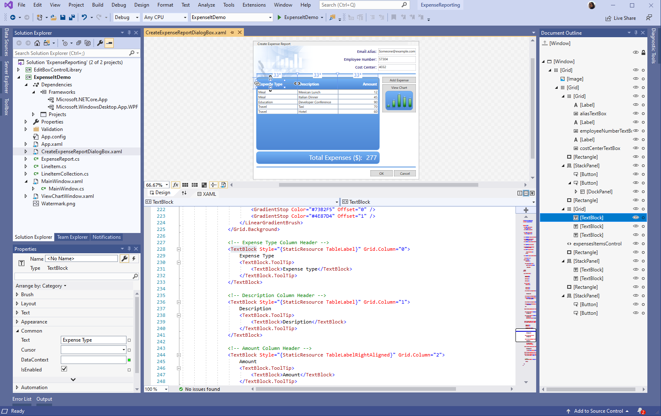
.NET Core 3.1
RELEASED
Long-Term Support (LTS) Preview 2
WPF and Windows Forms support
Side-by-side support & self-contained EXEs
Full-stack web development with C# and Razor
New C# 8.0 language features
dot.net

Slide 16
ASP.NET Core
Optimized for modern web applications and cloud-based hosting scenarios.
Modular design.
Include features to improve application security and performance.
Easily tested with automated tests
Notes:
ASP.NET Core is optimized for modern web applications and cloud-based hosting scenarios. Its modular design enables applications to depend on only those features they actually use, improving application security and performance while reducing hosting resource requirements.

Slide 17
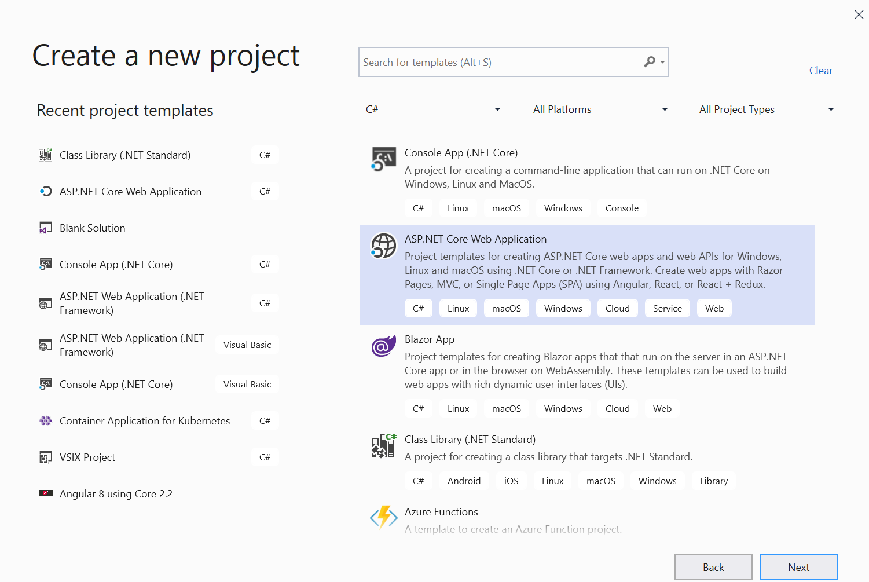

Slide 18
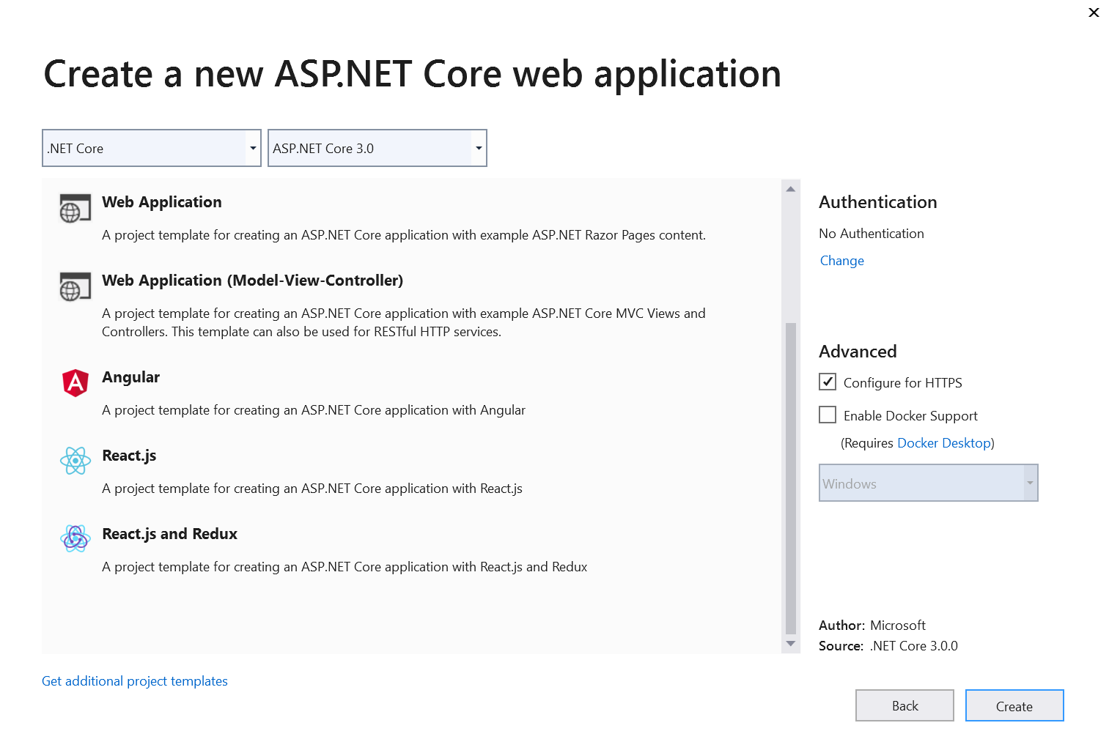

Slide 19

Blazor
Build interactive web UIs using C# instead of JavaScript.
Blazor apps are composed of reusable web UI components implemented using C#, HTML, and CSS.
Client and server code is written in C#, allowing you to share code and libraries.

Slide 20
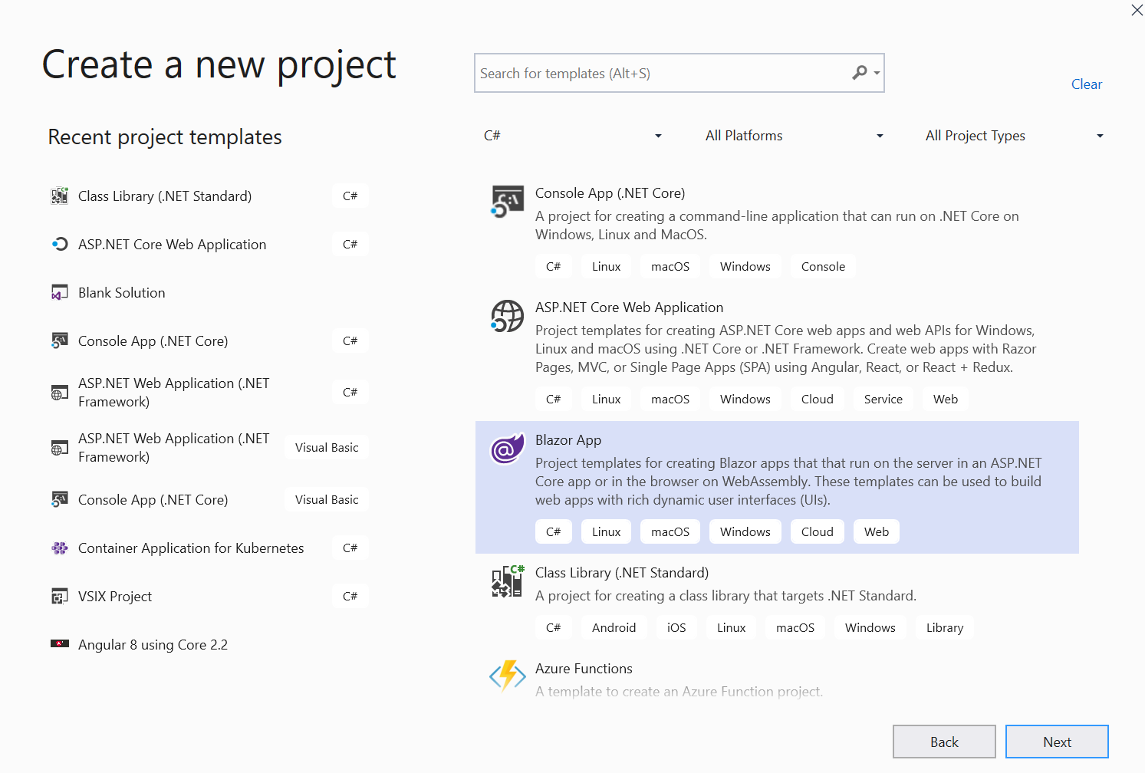

Slide 21
Technologies and Patterns
Notes:
Popular JavaScript libraries and frameworks are incredibly useful tools for any front-end web designer to be familiar with. They can add powerful functionality to your site or help you create current web design trends, resulting in exceptional experiences for your users. I

Slide 22



Evolution of Software architecture
1990's
Spaghetti-Oriented architecture
Copy & paste
Traditional "N-Layer" architecture applications
2000's
Lasagne-Oriented architecture
Layered monolith
Monolithic containerized applications
2010's
Ravioli-Oriented architecture
Microservices
Cloud architecture
Notes:
It looks like Software development and architecture have always been linked to italian food. So here is my take on the evolution of software architecture with an italian food perspective!

Slide 23
Architectural principles
SOLID Software Design Principles
Microservices Design Principles
Independent Deployment
Modularity
Communication
Size
Single Responsibility
Open/Closed
Liskov Substitution
Interface Segregation
Dependency Inversion
Notes:
You should architect and design software solutions with maintainability in mind. The principles outlined in this section can help guide you toward architectural decisions that will result in clean, maintainable applications. Generally, these principles will guide you toward building applications out of discrete components that are not tightly coupled to other parts of your application, but rather communicate through explicit interfaces or messaging systems.

Slide 24

Microservices architecture
Model approach for distributed and large or complex critical applications that are based on multiple, independent subsystems in the form of autonomous services.
Application is built as a collection of services car be developed, tested, versioned, deployed, and scaled.
S5
S3
App1
App 2
S1
S4
S4
S6
S1
S2
S3
S4
S5
S6
S2
S5
S1
S3
S2

Slide 25
Patterns | Technologies
Microservices
Docker Containers
Autonomous
Bounded Context
Linux Containers
Docker Image
Nomad & addressable services
Isolated
Docker Host
API Gateway
Windows Containers
Docker Registry
Decoupled
Docker Hub
Events
Async. communication
Hyper-V Containers
Event Bus
Message Brokers
Azure Service Bus
Azure Container Registry
Service Discovery
Health Checks
Orchestrators
Transient Failures Handling
Resiliency
Azure Service Fabric
Stateful Services
Commands
Actors
Retries with Exponential Backoff
Azure Container Service
Domain-Driven Design
Circuit Breakers
RabbitMQ
CQRS simplified
Kubernetes
NServiceBus
Aggregates
Docker Swarm
MassTransit
Domain Entity
Domain Events
Mesos DC/OS
Brighter
Mediator
Polly

Slide 26



Tools
GitHub
Visual Studio
Visual Studio Code
Visual Studio Online

Slide 27
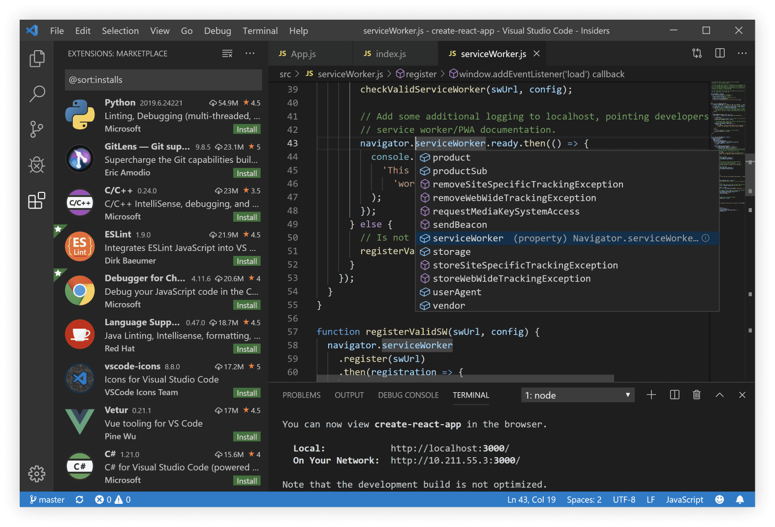
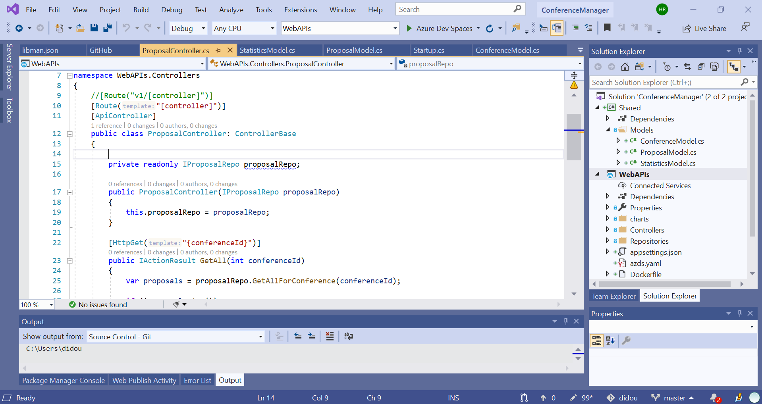
Visual Studio 2019
RELEASED
Edit productively with IntelliCode and additional refactorings
Collaborate with Live Share and GitHub integration
Improve code quality with historical debugging and live unit testing
visualstudio.com/downloads

Slide 28
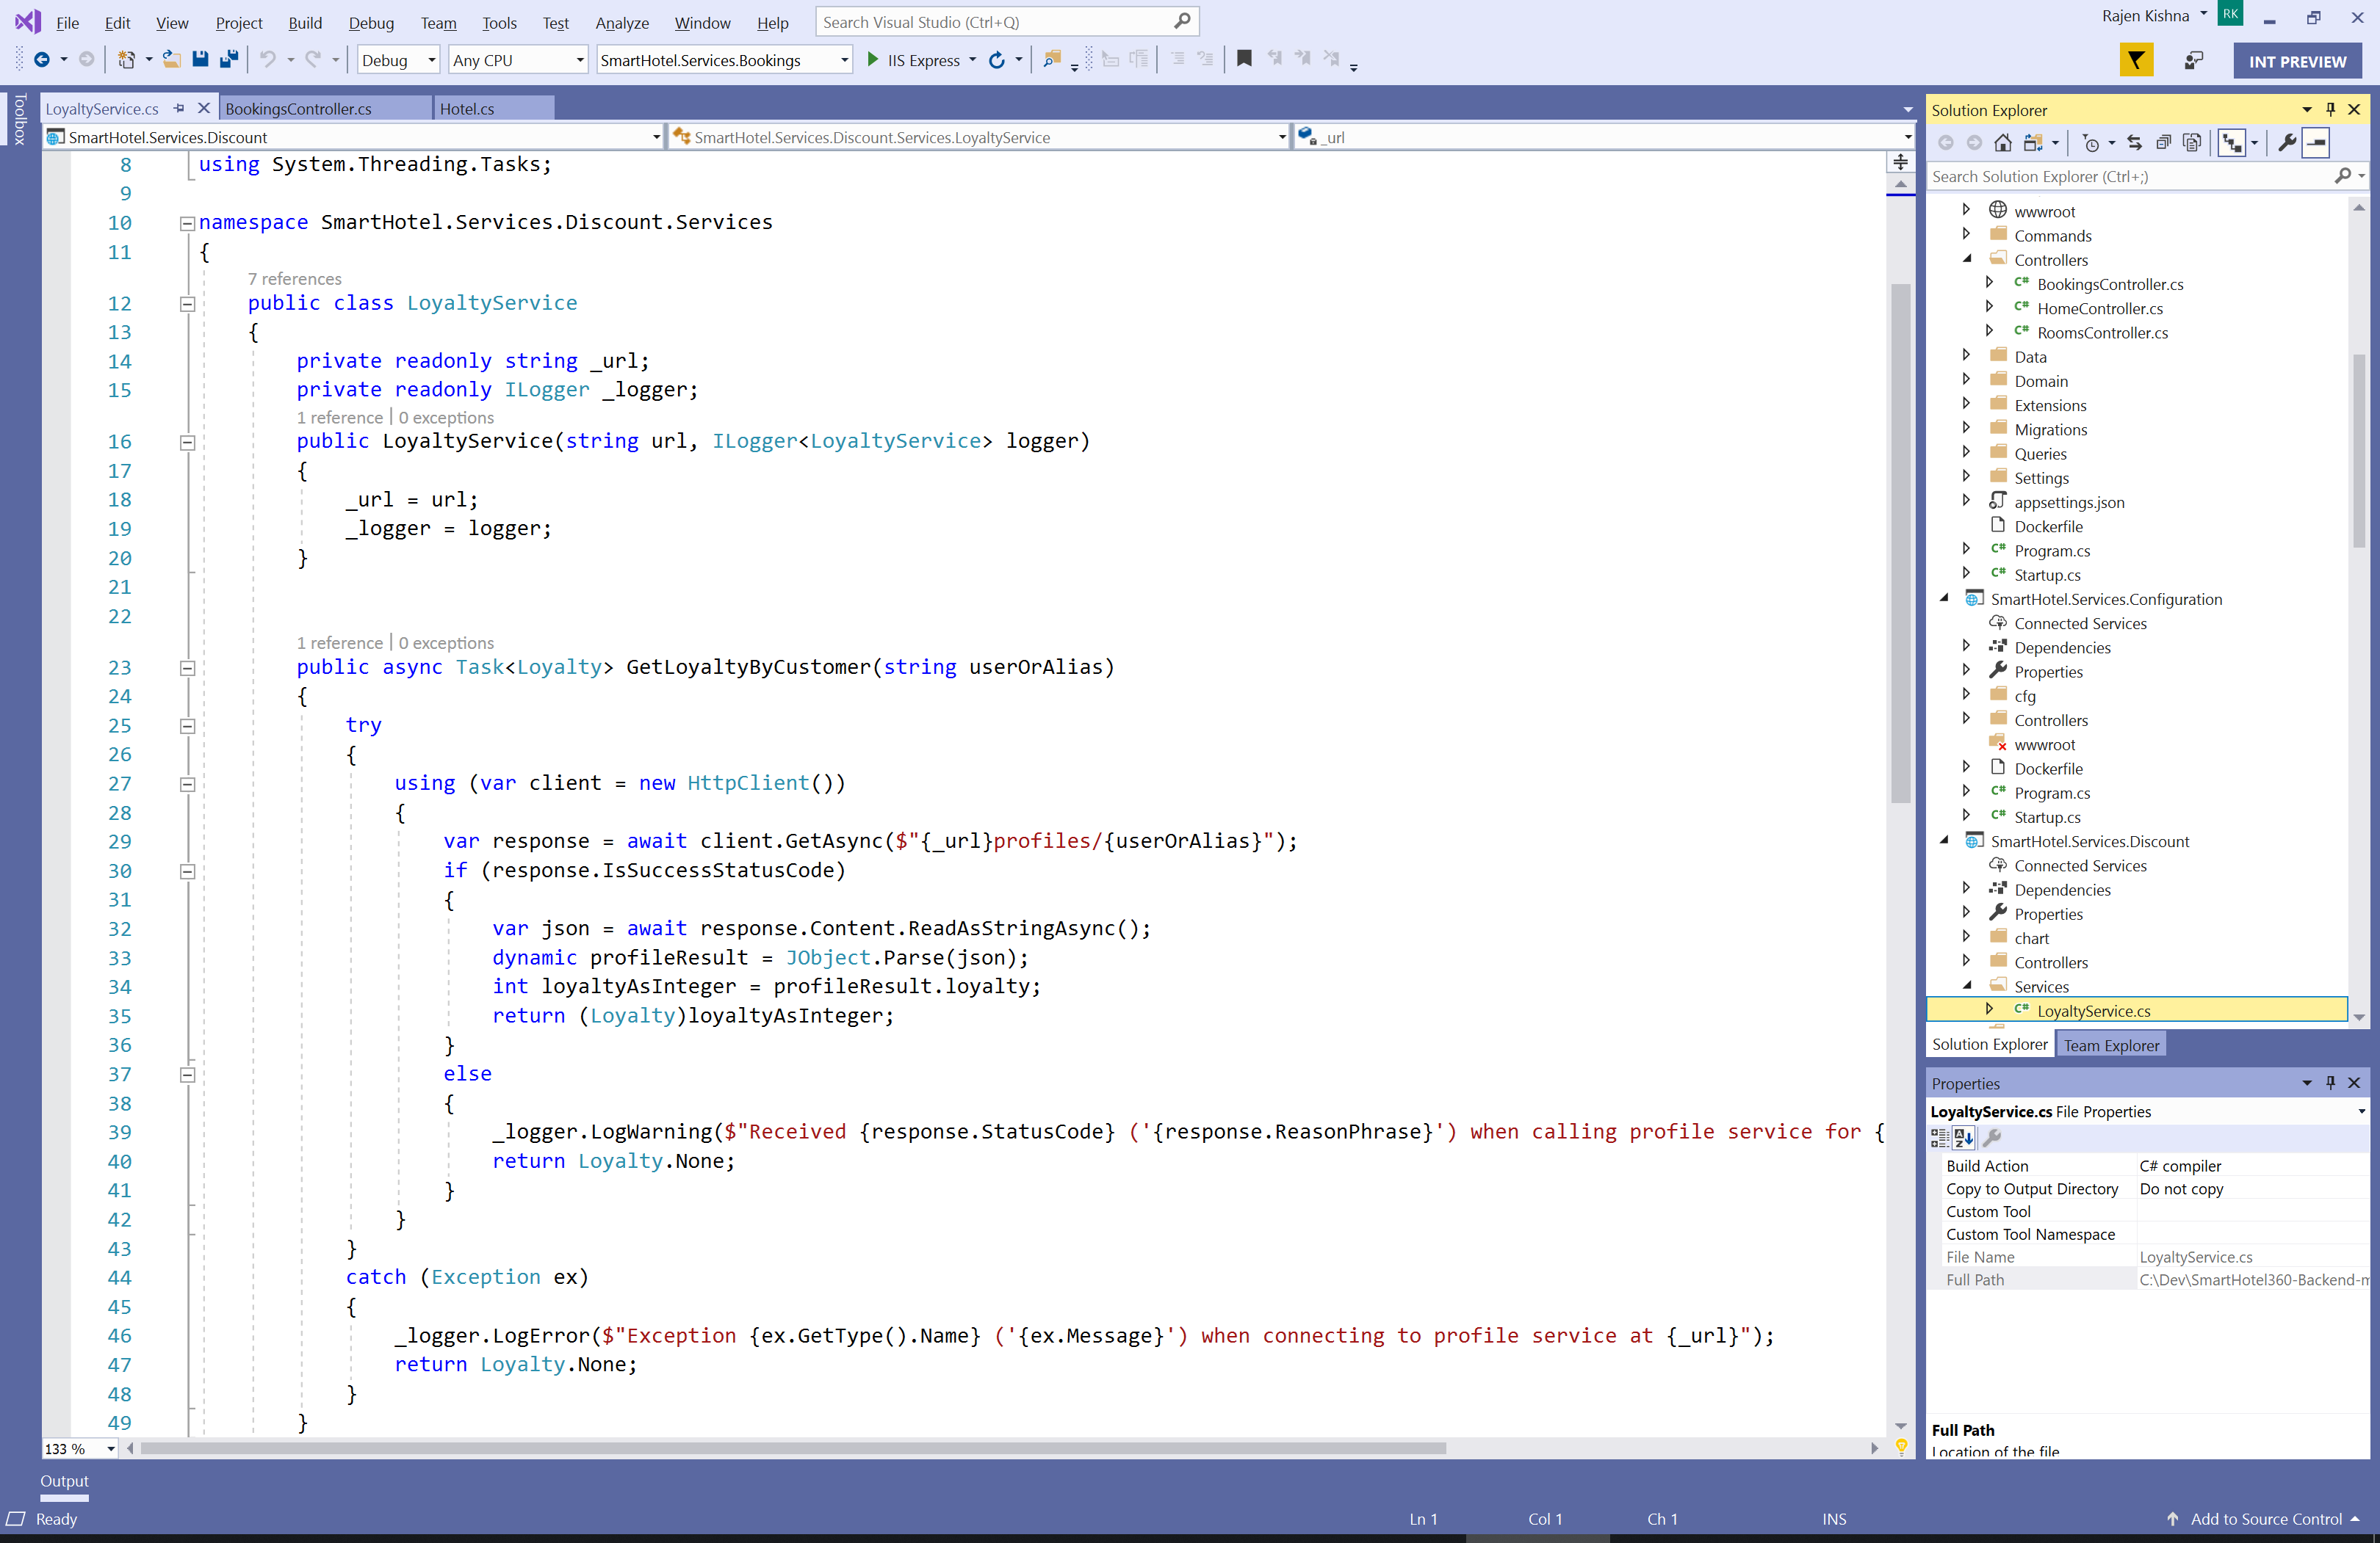
Visual Studio Code
Edit and debug across macOS, Linux, and Windows
Strong ecosystem of over 16k extensions, themes, and tools
Work in containers, WSL, or over SSH with remote development
visualstudio.com/downloads

Slide 29
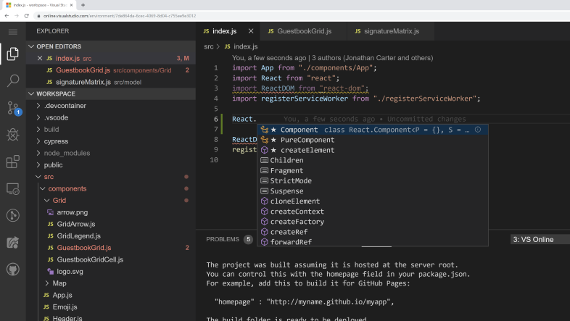
Visual Studio Online
Preview
Accessible cloud development environments from anywhere
Environnements managés pour n’importe quel projet
Expand anywhere
Supports Git repositories, extensions, and an integrated command-line interface
https://visualstudio.microsoft.com/fr/services/visual-studio-online/

Slide 30

Languages

Slide 31
Modern Apps on Azure with Docker

Slide 32

Docker container
Notes:
Technology that allows the creation and use of containers.
Tool that allows developers and sys-admins to easily deploy their applications in a sandbox (containers) to run on the host operating system i.e. Linux.

Slide 33





Containers in Azure
App Service
Service Fabric
Kubernetes Service
Container Instances
Batch

Slide 34
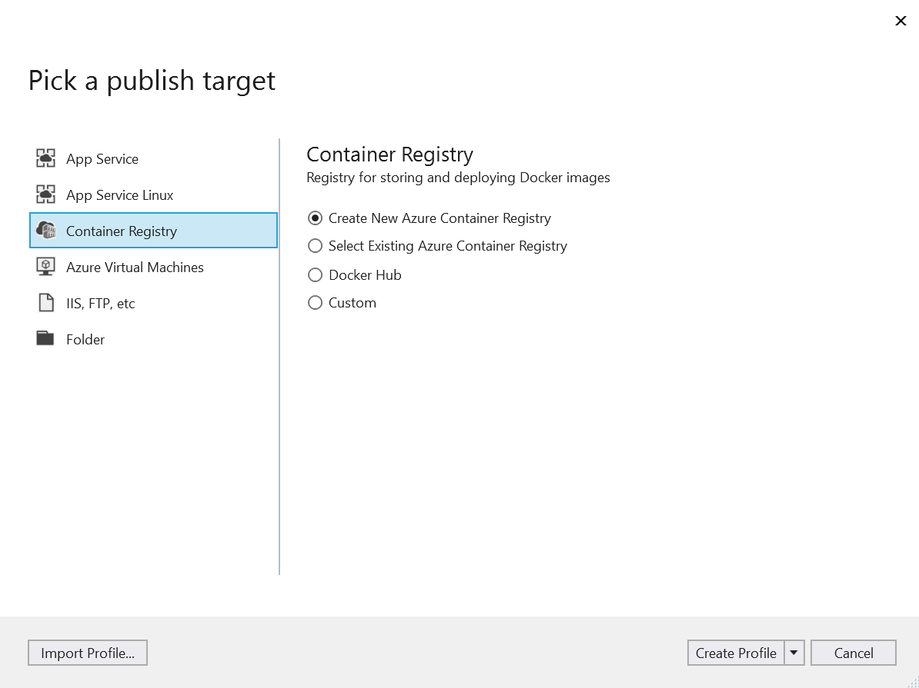
Deploy to Azure

Slide 35
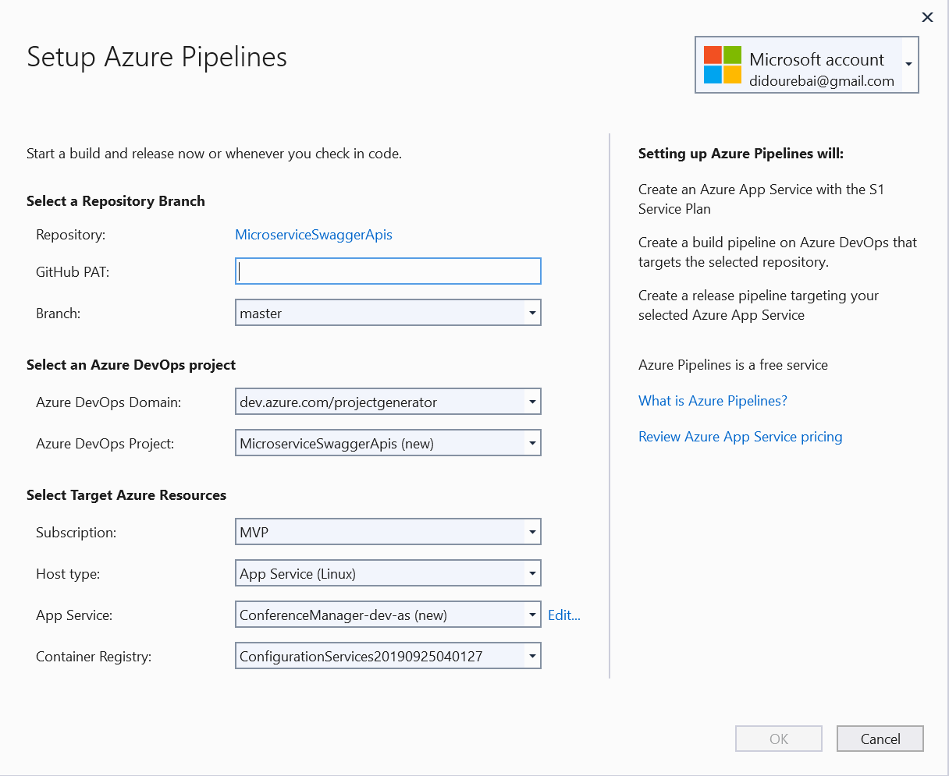
Configure CI-CD to Azure

Slide 36
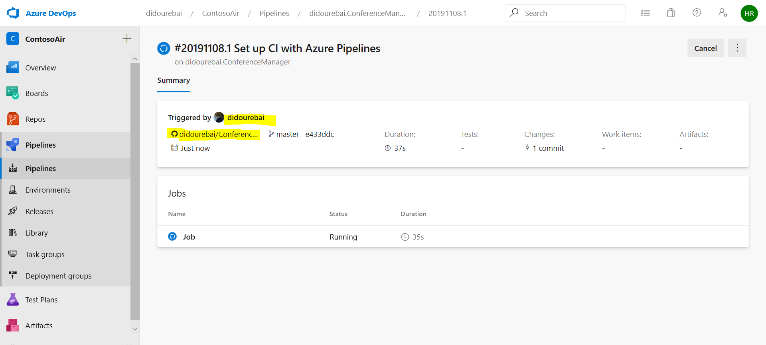
Set up CI with Azure Pipelines from Github source

Slide 37

Hamida REBAI TRABELSI
MVP in Developer Technologies
. Net Consultant
Twitter: @rebaihamida
Email: didourebai@gmail.com

